Slide 1

CSI 758 Project Kaggle Data Science Bowl 2017 Lung Cancer Detection
Bruce Goldfeder
May 4, 2017

Slide 2
Understanding the Data
Anonymized, high-resolution lung scans from hundreds of patients low-dose CT technology scans.
Three Data Sets of DICOM images
Sample set of 20 Dicom, Stage1(70GB), Stage2(40GB)
Each DICOM image had approximately 100 - 200 sub-images
2D layer of the scan – each of size [512,512] in color
Aggregated makes a 3D image
Label File with Binary of Has Cancer = 1, No Cancer = 0
Subset of patients identified to be used as training set
Number of
Sub-Images Cancer? Image Size
=====================================
134 0 (512, 512)
128 0 (512, 512)
133 0 (512, 512)
110 0 (512, 512)
203 1 (512, 512)
id | cancer
0015ceb851d7251b8f399e39779d1e7d | 1
0030a160d58723ff36d73f41b170ec21 | 0
003f41c78e6acfa92430a057ac0b306e | 0
006b96310a37b36cccb2ab48d10b49a3 | 1

Slide 3
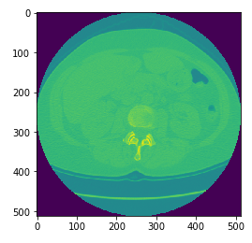
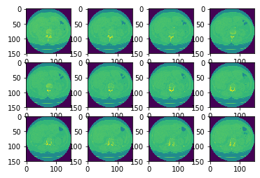
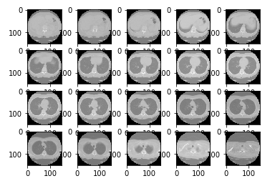
Visualizing and Conditioning the Data
Convolutional Neural Nets (CNN) use small image sizes typically 64x64 or smaller and the same number of inputs
This presents a conditioning problem in how to get [512,512] x ~200 layers into that format!!!
Techniques – Resize, Chunk Layers together to same number per Dicom using an averaging function
Original 2D Slices
Resized 2D Slices
20 “Chunks” per Dicom

Slide 4
Pre-Process Data for 3D CNN
Needed to accommodate variance in number of images per Dicom
Used chunking function with adjustments
Approximated the number of images to get 20 groups of adjacent images
Averaged the pixel values over the range of adjacent images to normalize for each group
Some data fidelity loss – estimate that tumor size that could be observed moved from millimeters to about a centimeter in size due to averaging.
Result was approximately 1500 images each with 50 pixels by 50 pixels by 20 images – this is the basis for the common 3D model to be input to the CNN

Slide 5
3D CNN Using Tensor Flow
Epoch 1 completed out of 10 loss: 238734260925.0
Accuracy: 0.6
Epoch 2 completed out of 10 loss: 18683134593.9
Accuracy: 0.7
Epoch 3 completed out of 10 loss: 7478595325.29
Accuracy: 0.7
Epoch 4 completed out of 10 loss: 3809845549.84
Accuracy: 0.9
Epoch 5 completed out of 10 loss: 2490083642.7
Accuracy: 0.4
Epoch 6 completed out of 10 loss: 1678082050.97
Accuracy: 0.5
Epoch 7 completed out of 10 loss: 1223602945.69
Accuracy: 0.6
Epoch 8 completed out of 10 loss: 760098937.574
Accuracy: 0.8
Epoch 9 completed out of 10 loss: 433012339.411
Accuracy: 0.9
Epoch 10 completed out of 10 loss: 242587365.832
Accuracy: 0.6
Done. Finishing accuracy:
Accuracy: 0.7
fitment percent: 0.9992790194664743
Difficult to install – both hardware and software dependencies
In future will use pre-built AWS Data Science AMI on Ubuntu
Not Instance Type transportable
Data was reduced dramatically
512x512x200 = 52MB to 50x50x20 = 50K; 99.9% loss
Still this was a large amount of data for a CNN
Works great on 2D kitten images of 64x64 = 4K
Not enough data samples
CNN wants 100K or more sample size

